Slide 1

Computer Organization and Assembly Language CS

Slide 2
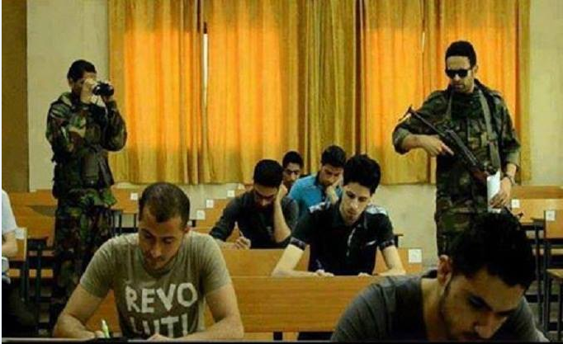
During Quiz !!!
Do your own work, Strict policy, Good Luck !!!

Slide 3
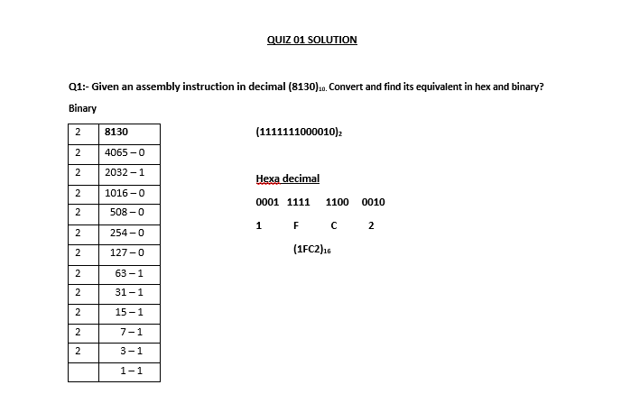
..

Slide 4
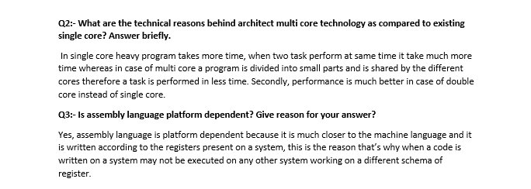

Slide 5
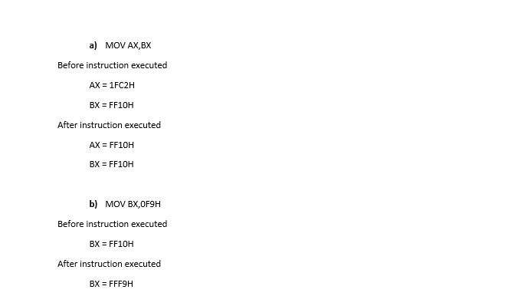

Slide 6
CPU Performance

Slide 7
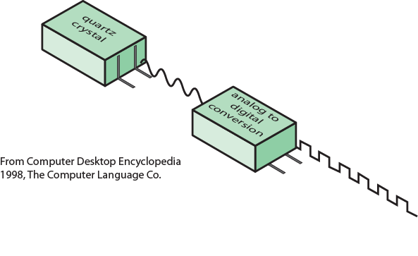
System Clock :

Slide 8
Performance Assessment : Clock Speed
Key parameters:
Performance, cost, size, security, reliability, power consumption
System clock speed
In Hz or larger multiples of it.
Clock rate, clock cycle, clock tick, cycle time.
Operations need to be synchronised.
Instruction execution in discrete steps.
Fetch, decode, load and store, arithmetic or logical
Usually require multiple clock cycles per instruction
Pipelining gives simultaneous execution of instructions
So, clock speed is not the whole story

Slide 9
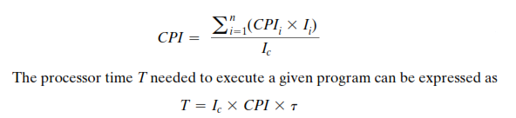

Instruction Execution Rate :
The average CPI is defined as: clock per instruction
The effect of memory access, if taken into account
where p is no. of cycles needed to execute/decode instruction
m is number of memory reference needed
k is ratio b/w memory & processor cycle time.

Slide 10
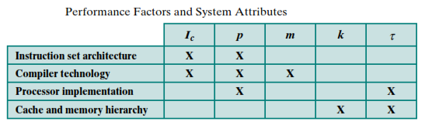
Instruction Execution Rate :
Heavily dependent on
Instruction set
Compiler design
Processor implementation
Cache & memory hierarchy

Slide 11

Instruction Execution Rate :
Millions of instructions per second (MIPS)
Millions of floating point instructions per second (MFLOPS)
What are the Benchmark programs & their importance in performance measurements?

Slide 12
Instruction Performance
Clocks Per Instruction, CPI
The average number of clock cycles each instruction takes to execute.
Exercise:
Which computer is faster?
Computer | Clock Cycle Time | CPI
A | 250 picoseconds | 2
B | 500 picoseconds | 1.2
Solution : # of instructions in a program =
CPU-A: CPU Execution Time = × × ps = ps
CPU-B: CPU Execution Time = × × ps = ps
Computer A is ( / ) = times faster than B

Slide 13
Instruction Performance
 | Instruction Class
 | A | B | C
CPI | 1 | 2 | 3
Exercise:
Given 3 groups of instructions: A, B and C, it takes different clock cycles to execute an instruction within each group.
Given the shown instruction mix, which code sequence is faster to execute?
Code | Instruction Count
 | A | B | C
Seq1 | 2 | 1 | 2
Seq2 | 4 | 1 | 1
Seq1: CPU Execution Time = × + × + × = cycles
Seq2: CPU Execution Time = × + × + × = cycles
Seq1 average CPI = = cycles / instruction
Seq2 average CPI = = cycles / instruction
Seq2 is / = times faster than Seq1

Slide 14
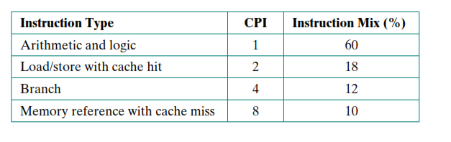
Class Example :
Consider a 400MHz processor executing instructions given in Table, taking specified CPI per instruction & instruction mix. Calculate effective CPI and MIPS for this processors?

Slide 15
Your Turn !!!
Solution:

Slide 16
AL instructions execution

Slide 17
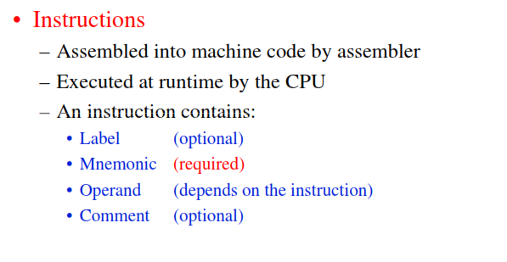
Ingredients of AL instruction :

Slide 18
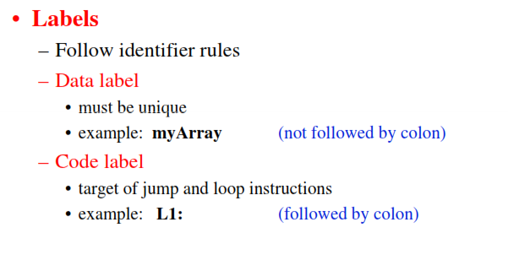
Ingredients of AL instruction :

Slide 19
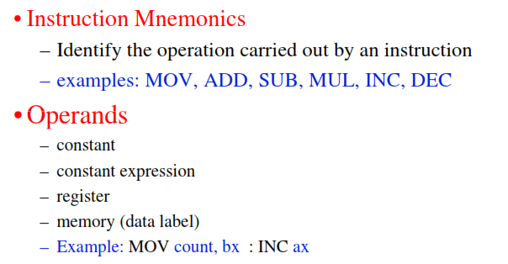
Ingredients of AL instruction :
stc (set carry flag, no operand)

Slide 20
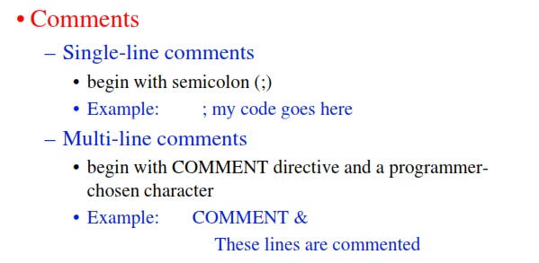
Ingredients of AL instruction :

Slide 21
Instruction Encoding / Decoding
Instruction Format
Machine Language & Machine Code
Machine code is what u store in memory.
Encoding / decoding is done by CPU at
the time of instruction execution.
Assembly Language
Op code
Operands
ADD R1, R2, 47
5 1 2 2F
0101
0001
0010
00101111
5 1 2 2 F
Machine Language

Slide 22
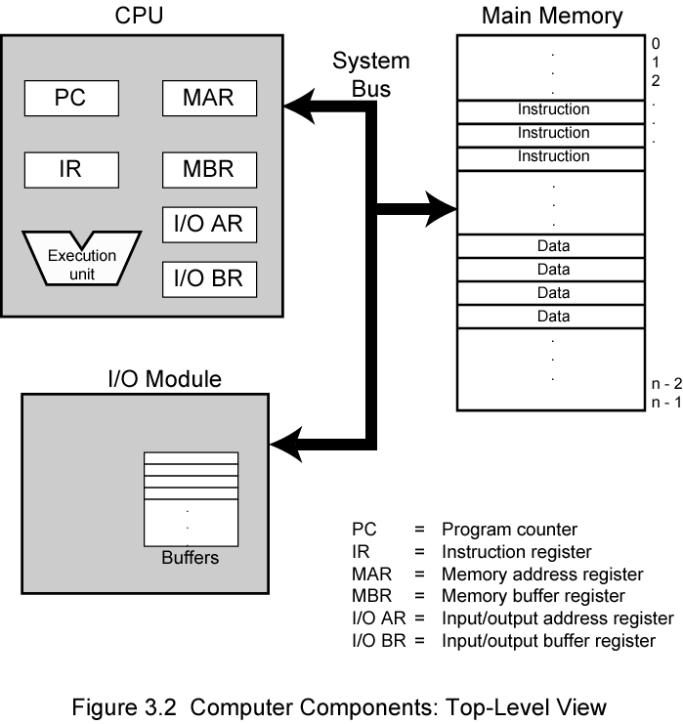
Instruction Processing Components:

Slide 23
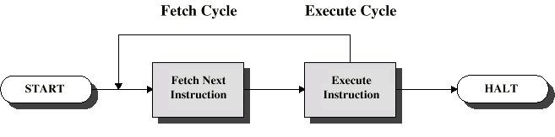
Instruction Cycle : Basic steps
Basic two steps:
Fetch
Execute
Detailed steps are discussed ahead.

Slide 24
Fetch Cycle
Program Counter (PC) holds address of next instruction to fetch.
Processor fetches instruction from memory location pointed to by PC.
Increment PC.
Unless told otherwise
Instruction loaded into Instruction Register (IR).
Processor interprets instruction and performs required actions.(Decoding of instruction.)

Slide 25
Execute Cycle
Processor-memory
data transfer between CPU and main memory
Processor- I/O
Data transfer between CPU and I/O module
Data processing
Some arithmetic or logical operation on data
Control
Alteration of sequence of operations
e.g. jump
Combination of above

Slide 26
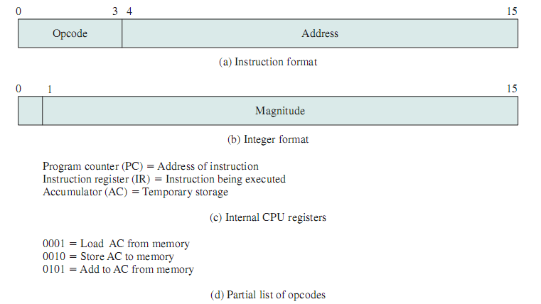
Instruction Execution : Detailed Example
Example :Designing, encoding/decoding an instruction execution

Slide 27
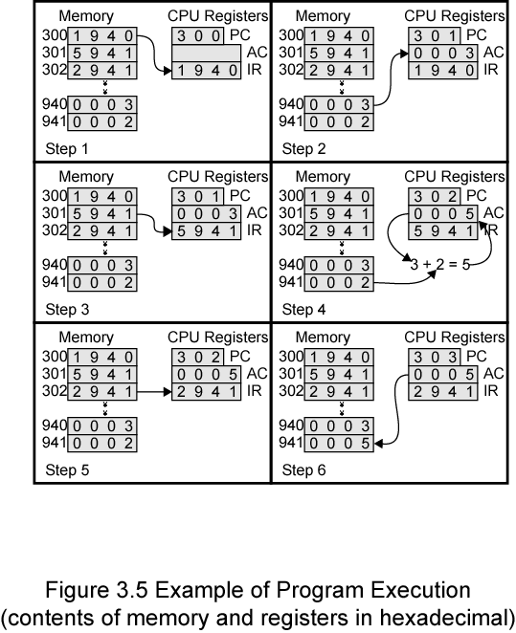
Instruction Execution : Detailed Example

Slide 28
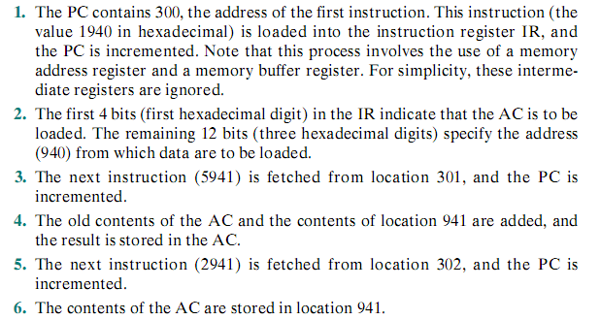
Instruction Execution : Detailed Example

Slide 29
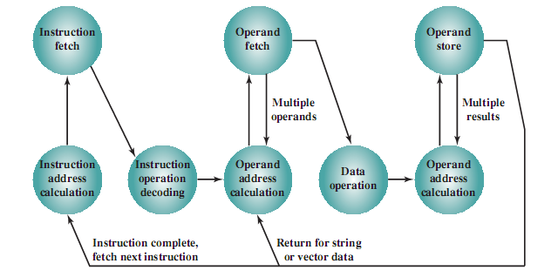
Instruction Cycle : State Diagram

Slide 30
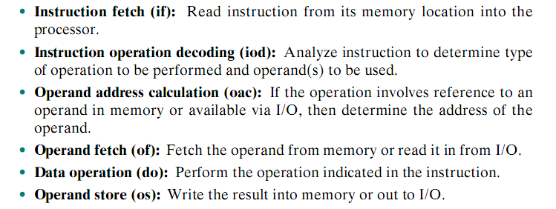
Instruction cycle : Detailed steps
Detailed steps, involved in an instruction cycle, are as under

Slide 31
THANKS ALL
The End

